Slide 1


Slide 2









By

Slide 3

Who we are:
Scum Trainer – Живко Нанев
Back End – Даниел Георгиев
Front End – Добрин Пейчев
Code Checker – Йоан Танев

Slide 4
Живко Нанев
• Scum Trainer •

Slide 5
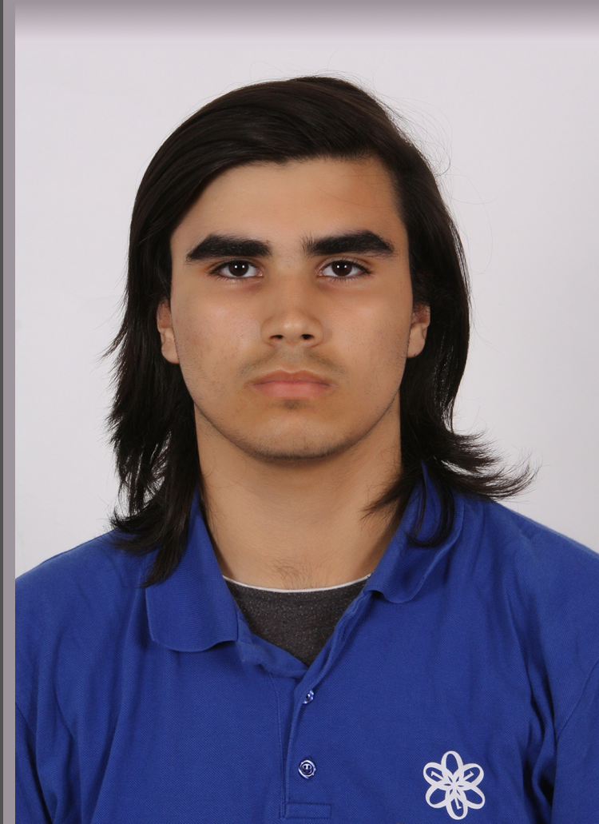
Даниел Георгиев
• Back End •

Slide 6
Добрин Пейчев
• Front End •

Slide 7
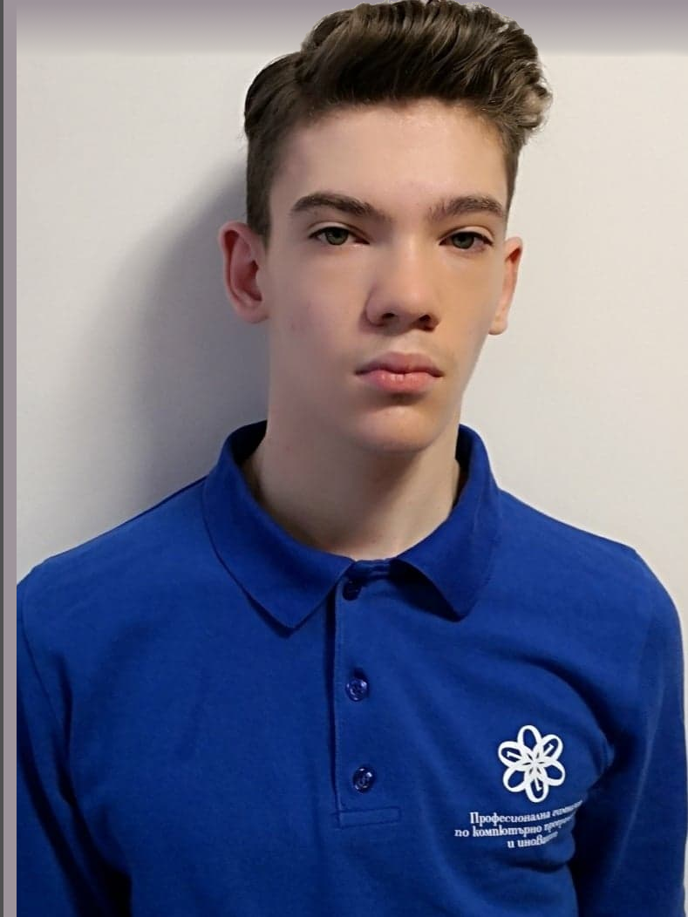
Йоан
Танев
• Code Checker •

Slide 8
The Project:
Our game is named “Butterfly effect”. Its genre is text adventure horror. The player uses text input to control the game, and the game state is relayed to the player via text output. Basically, you have to make decisions which can change the future dramatically.

Slide 9

But…

Slide 10

We couldn’t complete in time

Slide 11

So that’s why we decided to start from scratch

Slide 12
It took us a long sleepless night, but we managed to do it

Slide 13
Our new project is called
HangMan

Slide 14
Basically, HangMan is a paper and pencil guessing game for two or more players. One player thinks of a word, phrase or sentence and the other(s) tries to guess it by suggesting letters within a certain number of guesses.

Slide 15

“But at least we managed to do it”

Slide 16

The End

